Slide 1
Data Service Server
EIS-S230
Sammy Hsu
8/14/2019

Slide 2

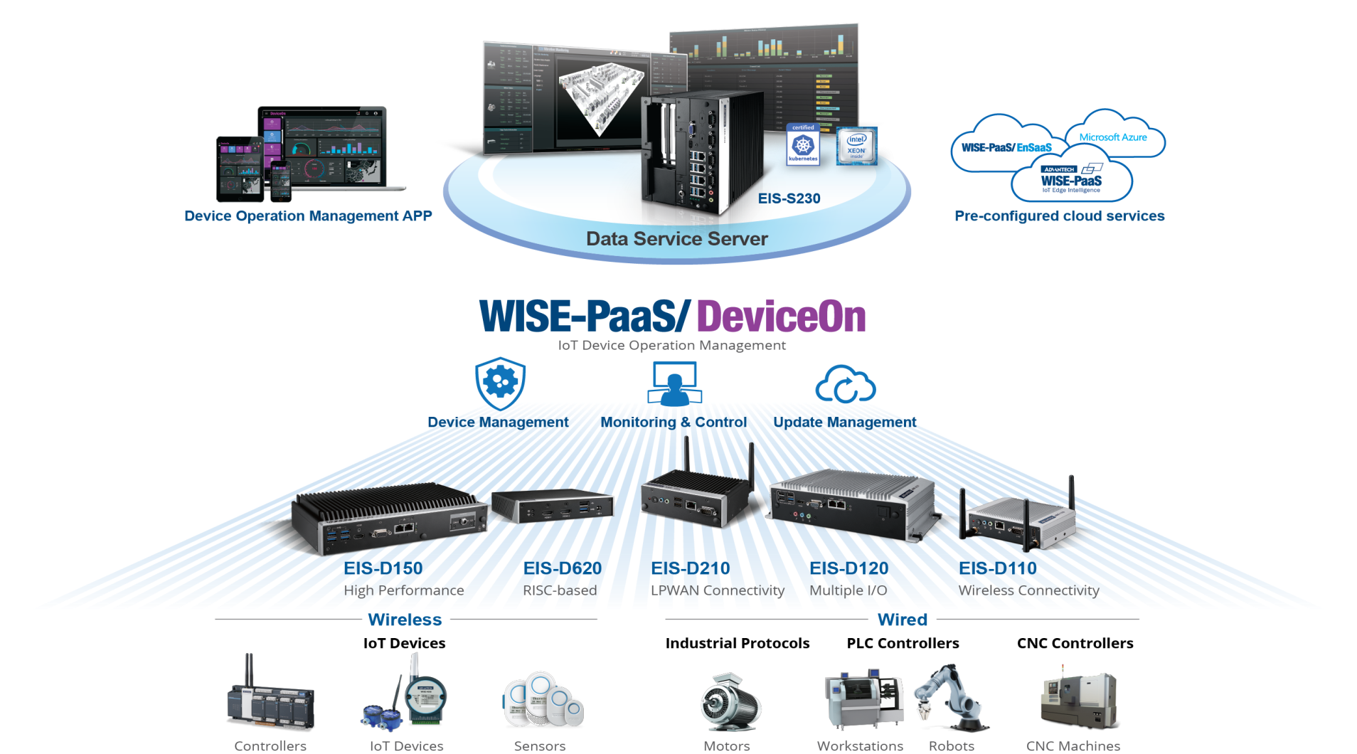





Edge Intelligence & Data Service Servers
Simplify IoT Deployment from Edge to Cloud

Slide 3



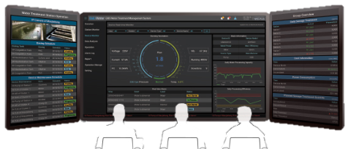


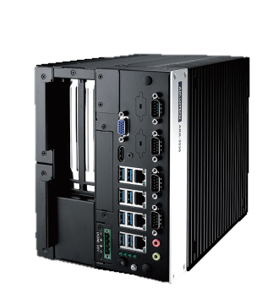
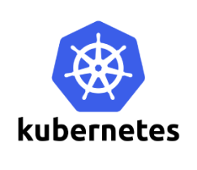






Data Service Server
Scalable On-premise Platform for Big Data Management
Equipment
Management
Smart
Retail
Optimizes
Manufacturing
Energy-efficient
Building
Easy
Scale-out
High
Availability
All-in-one Platform
Open Standard Structure
Kubernetes Built-in
Multiple DB Connections
On-demand Microservices
Integrated IoT Software
Private Cloud Deployment
Platform Management
Application Integration
Sustainable Management
Condition Monitor
Load Balance
Self-health

Slide 4




Target Marketing
Medical Devices Monitoring
Get real-time data from Medical Devices
Equipment Management
Through data collection, could be used to improve production processes
Industrial Transformation
Save more manpower through digital transformation
Energy Management System
Power efficiency analysis and predictive maintenance
Medical
Semiconductor
Factory
Energy

Slide 5






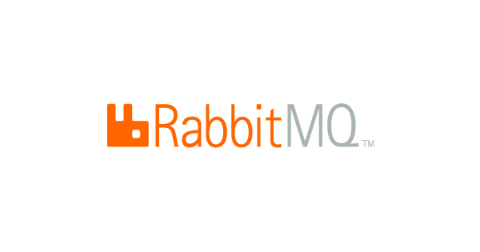




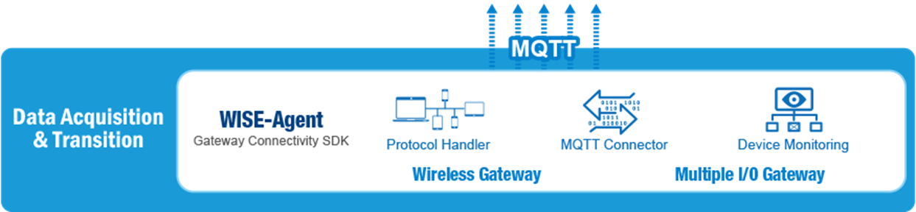
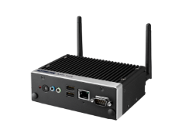


Data Service Server Architecture
Device management
Data Visualization
Data
Service
Package
Self-Healing
App Repository
Auto Scaling
Load Balancing
Backend Server Management
IoT Hub
Data Base Management
Edge Computing

Slide 6

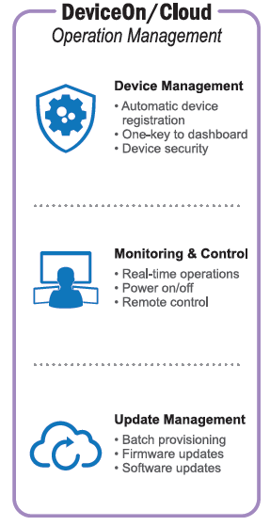


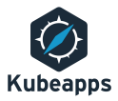




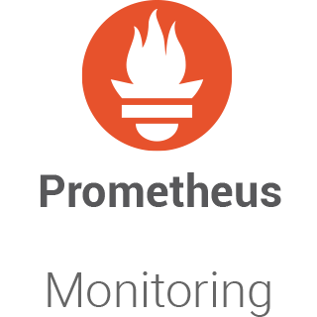
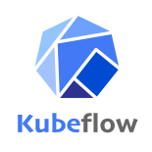

Software Stack
Platform Management
Applications
Message Broker
Data Visualization
Lightweight and easy to deploy on premises and in the cloud. It supports multiple messaging protocols..
Allows you to query, visualize, alert on and understand your metrics.
App Management
Backend Management
Kubeapps is a web-based UI for deploying and managing applications in Kubernetes clusters.
The Docker Registry is a stateless, highly scalable server side application that stores and lets you distribute Docker images.
ChartMuseum is an Helm Chart Repository server written in Go. It provides an API for uploading charts.
Runs on top of the same object storage system that provides object storage and block device interfaces.
Deployment, scaling, and management of containerized applications.
Database Management
A powerful, open source object-relational database system.
Prometheus is an open-source software application used for event monitoring and alerting.
MongoDB is a document database, which means it stores data in JSON-like documents.
Machine Learning
Making deployments of machine learning (ML) workflows on Kubernetes Device Management
Notes:
Check health status of services and heal them in need.

Slide 7


Flexible Extension
Master
Node
Flexible
Extension
On-demand Elastic scaling platform w/ HA
Dynamically scale out platform computing and storage by adding hardware server node
Increase the platform High Availability on demand
Cost efficiency
Lower Upfront investment and hosting cost
Put compute power at the edge to reduce network infrastructure and management costs, and remove unnecessary spending for storage capacity in cloud

Slide 8
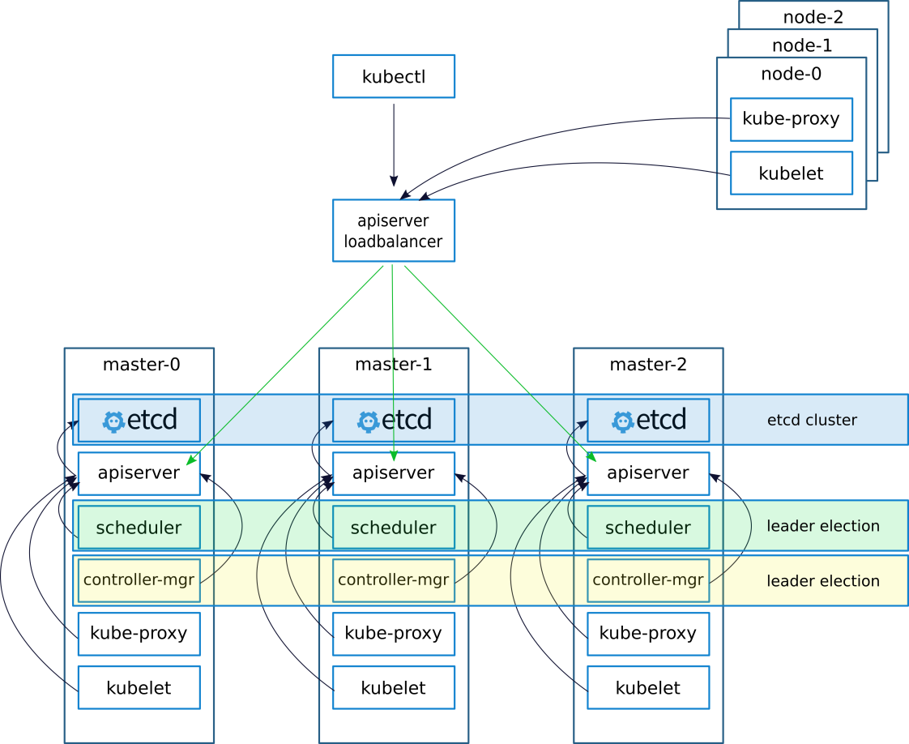
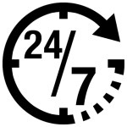
High-Availability Architecture
High
Availability
Optimized edge performance for IoT aggregation
Industrial-class hardware, 24/7 operation
Optimized edge system with high performance computing
Own your in-house Cloud and Data
High Device and Data Autonomy
Maximized data security and privacy
Fast application deploying and seamlessly migrating from cloud to edge

Slide 9

EIS-S230
Data Service Server
Hardware Specification
CPU | Intel® Xeon® E3-1275 V6
Memory | 32GB DDR4 ECC DDR4 2400
Storage | 512GB mSATA SSD (OS) 1TB/5TB 2.5” HDD/SSD x 2 (DATA)
OS | Ubuntu 16.04
LAN | 10/100/1000 Mbps GbE x 4
COM | 4*RS-232/422/485
Display | HDMI x 1, VGA x 1
Operating Temp. | 0 ~ 40°C

Slide 10
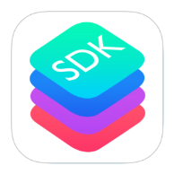
DeviceOn Software Development Kits
Device Management
Deploy and Monitor
Manage and Maintain
Update Software
Edge Intelligence and Sensing
Data Management
Collect and Store
Process and Analyze
Protocol Convert
Cater your customization needs on various protocols for data acquisitions, and application needs
WISE
Agent
Publish
MQTT
Broker
Publish
Common Data Workers
Message
Message
Custom/SRP
Data Workers
Subscribe
Subscribe

Slide 11
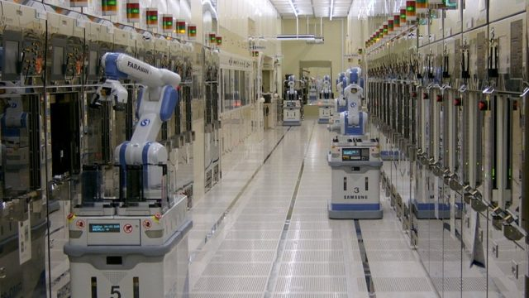
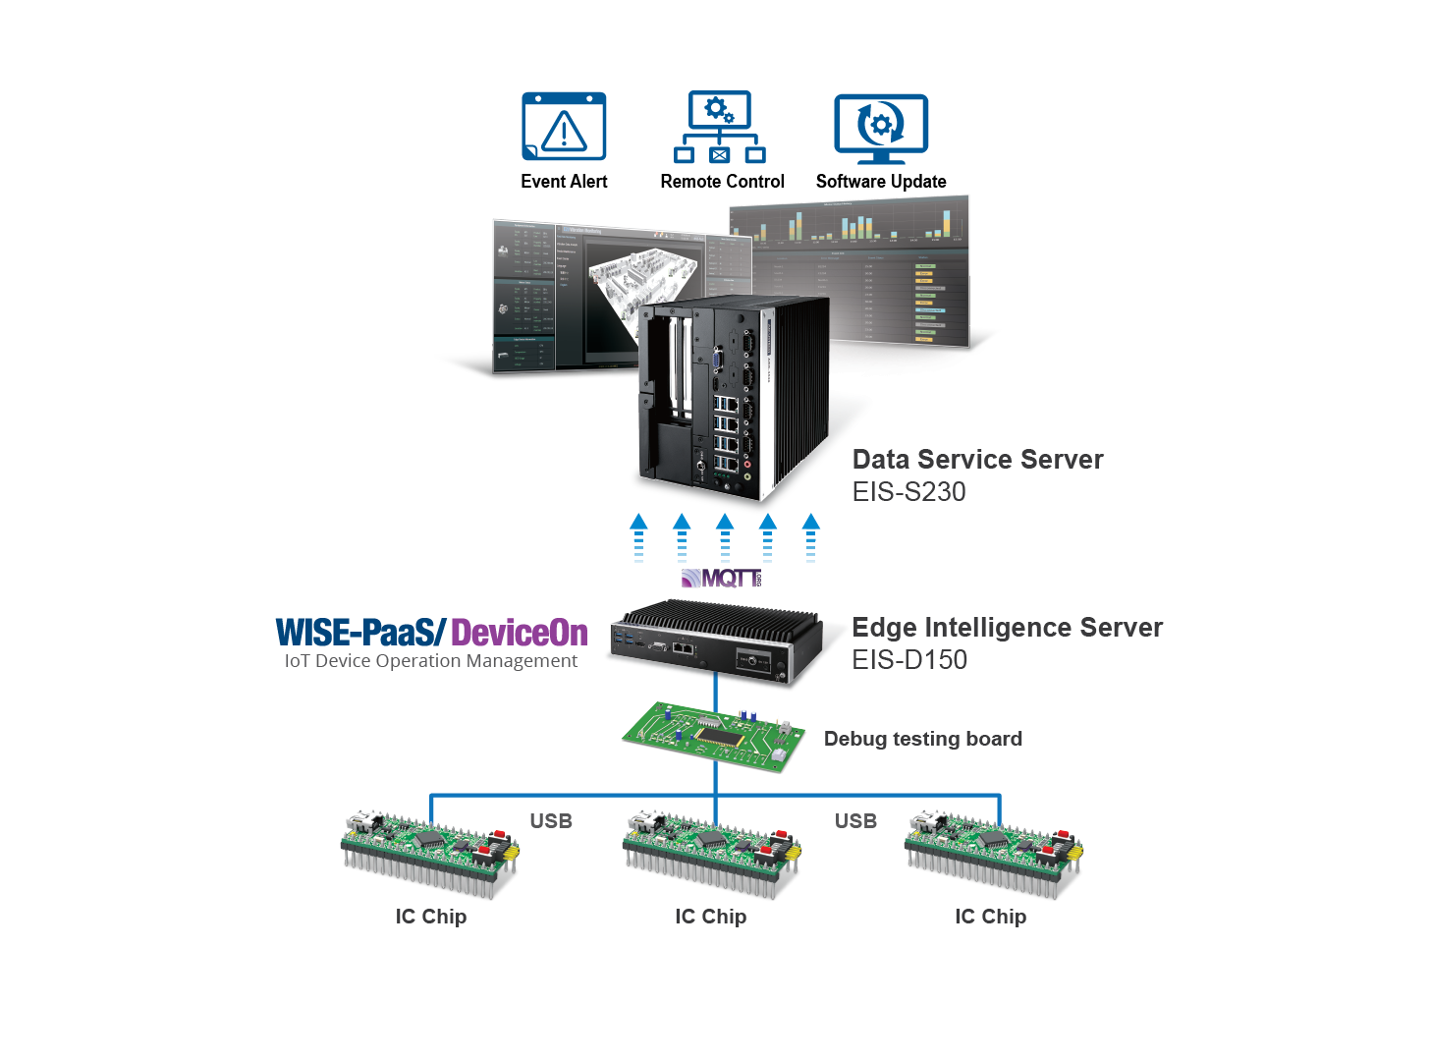
Case Study I:
Remote Monitoring System Optimizes IC Testing
Workflow Efficiency and Productivity
• Enhances equipment management, optimizes the IC test process, and improves overall productivity and efficiency.
• The implementation of remote monitoring and software updates via OTA technology reduces the workload of the IC testing department.
• Industrial-grade computers provide higher robustness and reliability on the production line environment

Slide 12
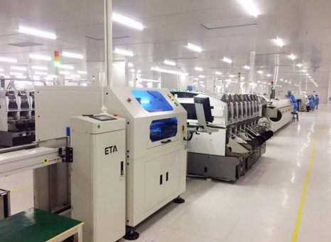
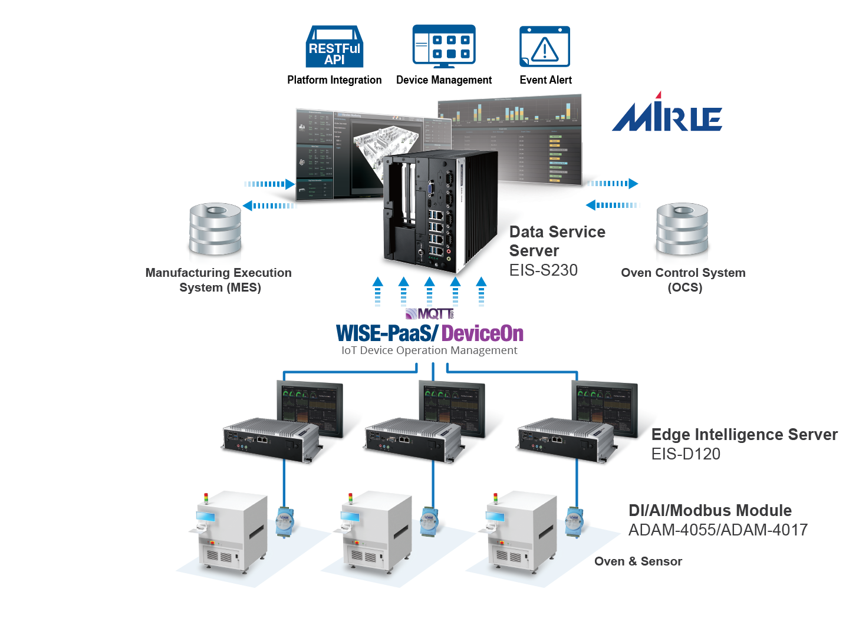
Case Study II:
Automatic PCB Baking Process and
Intelligent Asset Management
• Replaces traditional manual practices in the PCB baking process with automatic control and monitoring, improving productivity and yield rate.
·
• Produces digital records for users to keep track of the operational status of the baking ovens and also establish production information traceability for future lookups.
·
• Enables cross-platform integration with the customers other information systems, such as MES, so as to optimize workflow to higher efficiency.

Slide 13
Appendix

Slide 14
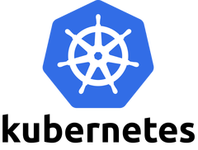
What is Kubernates (K8S)?
Kubernetes is a portable, extensible, open-source platform for managing containerized workloads and services, that facilitates both declarative configuration and automation. It has a large, rapidly growing ecosystem. Kubernetes services, support, and tools are widely available.
The name Kubernetes originates from Greek, meaning helmsman or pilot. Google open-sourced the Kubernetes project in 2014. Kubernetes builds upon a decade and a half of experience that Google has with running production workloads at scale, combined with best-of-breed ideas and practices from the community.

Slide 15

What is Kubeflow?
Kubeflow is the machine learning toolkit for Kubernetes.
To use Kubeflow, the basic workflow is:
Download and run the Kubeflow deployment binary.
Customize the resulting configuration files.
Run the specified scripts to deploy your containers to your specific environment.
You can adapt the configuration to choose the platforms and services that you want to use for each stage of the ML workflow: data preparation, model training, prediction serving, and service management.
You can choose to deploy your Kubernetes workloads locally or to a cloud environment.

Slide 16
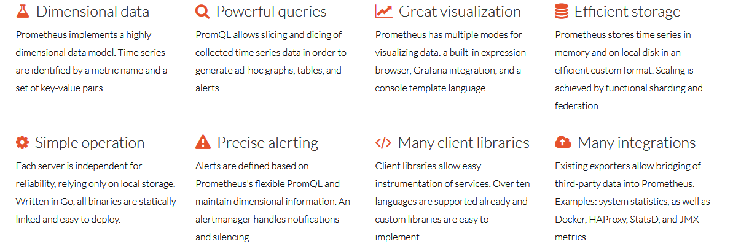
Prometheus Introduction

Slide 17

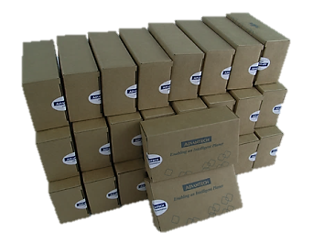
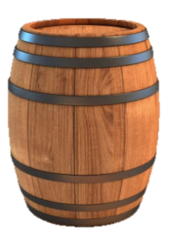

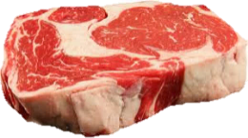
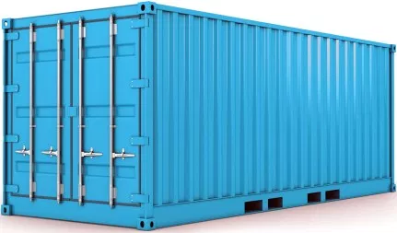
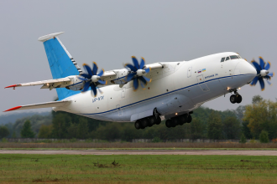



What is Container?

Slide 18
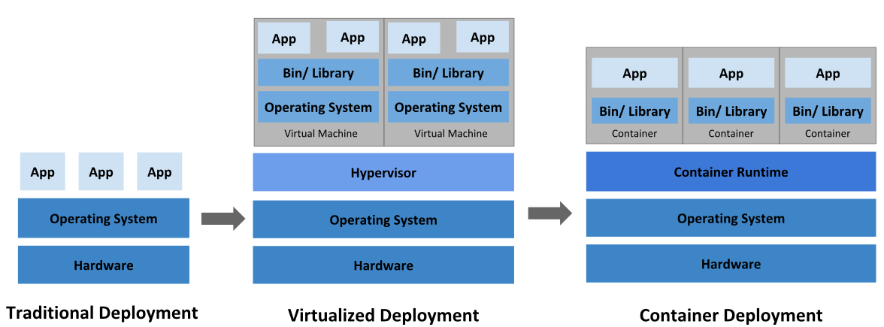
Deployment Evolution

Slide 19
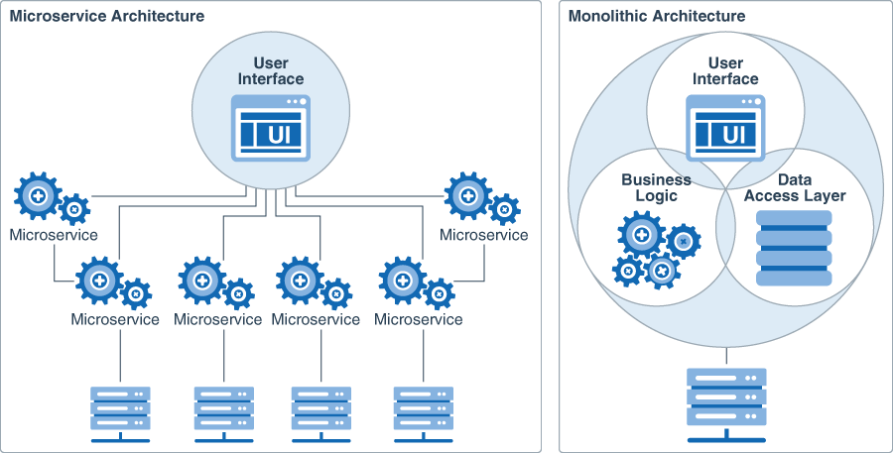
Microservice VS Monolithic Architecture

Slide 20
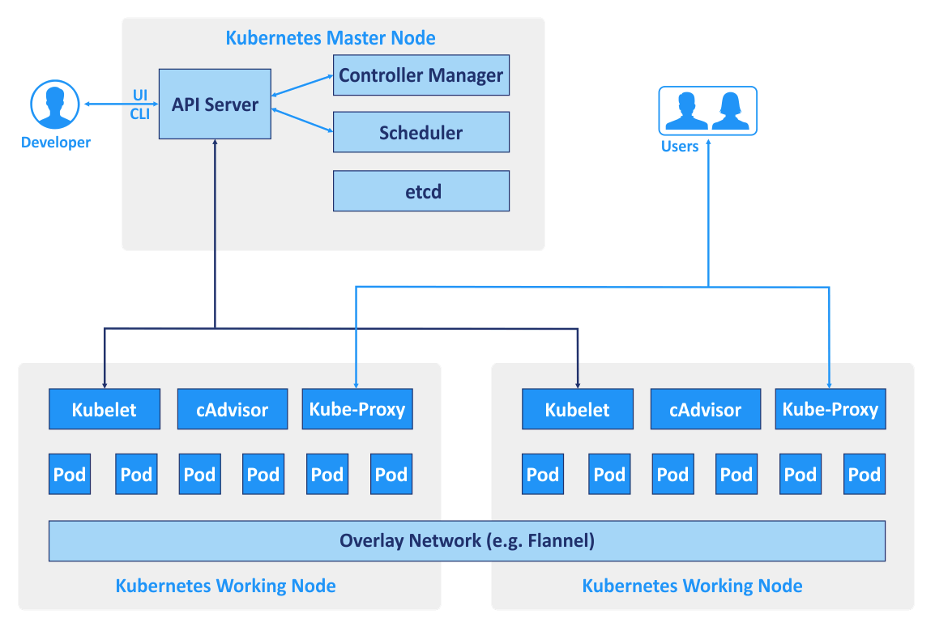
The Kubernetes architecture and scalability
Notes:
K8S為cluster的架構上面有master和node
Master為cluster的核心掌管cluster資源如何分配包含部屬的app要放在哪一台node上面
監控這些app是否正常
API server為認證kube ctrl command的地方，去管理user是否有權限做後續的操作
Controller manager及scheduler是掌管資源分配給哪一個node使用
Etcd為DB包含app放置在那些位置，export出來那些port，所有資源都會記錄在etcd內
Node內會有Kubelet的component負責接收master下達的指令
Cadvisor是監控node資源
Kubeproxy是node之間做溝通或是export service導出來給外面的user使用

Slide 21
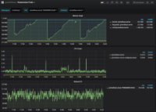
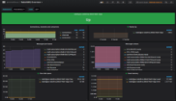
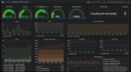
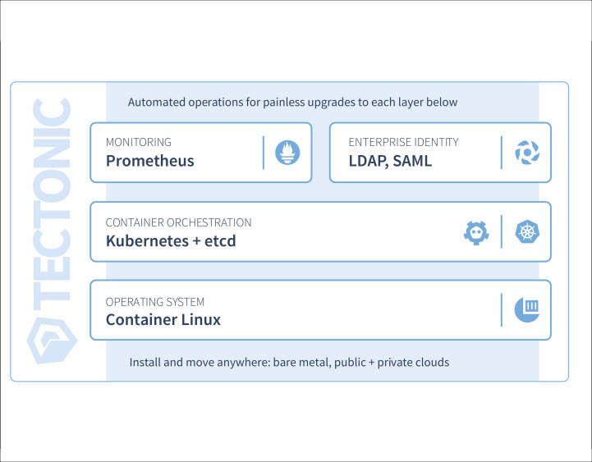
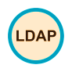
Management Tools
Management Tools Introduction
Health monitor and manager for
Cluster, Nodes, IoT Hub, Data Base and Applications
Automated operations for upgrades to each layers
MONITORING
ENTERPRISE INDENTITY
Prometheus
LDAP
CONTAINER ORCHESTRATION
Kubernetes + etcd
Scheduling, Load balance, Scaling, High Availability
OPERATING SYSTEM
Container Linux
Install and move anywhere : bare metal, public (Azure, AWS, Ali, Google) + private clouds

Slide 22
Naming Rule
EIS-S230-U20H2B1
Edge Intelligence Server
Memory Size:
0: none, 1: 1G,
2: 2G, 4:4G, 8: 8G,
A:16G B:32G
C:64G D:128G
Edge Intelligent Software:
0 : None
1: All (RMM, WebAccess/SCADA, IMM, HMI, OTA)
2:DeviceOn
3:WebAccess/SCADA
4.Kubernetes
5.RMM 4.X
Interface:
0 : None
D: Data
F: Fieldbus (CAN, PROFIN, CANBus..)
OS version:
Y : Yocto
P : IDP3.1
W: WES7E, Windows 7 pro
C : IoT core
E : Win 10 Ent
U : Ubuntu
0: No OS
Storage type :
00 : None / H5 : 500G HDD /
H1 : 1THDD / H2 : 2T HDD
S3 : 32G SSD / S6 : 64G SSD /
S1 : 128G SSD / S2 : 256G SSD
S5 : 512G SSD
Revision. Ex: 1,2…A,B
S:Server
2:CPU Generation
3:IPC Naming rule
0:Series generation

Slide 23
Data Service Package Component
Components | Services | Memory Used | Storage Allocated
Container Runtime | Moby | -
Persistent Storage | Ceph | 4G
Container Orchestration | Kubernetes | -
Database | MongoDB | 6G | 1152G
 | PostgreSQL | 0.512G | 8G
IoTHub | RabbitMQ | 6G | 64G
S3 Compatible Storage | Minio | 0.256G | 10G
System Monitoring | Prometheus | 2G | 256G
Visualization Dashboard | Grafana | 0.128G | 10G
Load Balancing | Nginx-Ingress | 0.512G
DNS | CoreDNS | 0.256G
Private Chart Repo | Chartmuseum | 0.128G | 8G
Device Management | WISE-PaaS/EdgeSense | 3.512G
Infrastructure
Ubuntu 16.04 Desktop
Kubernetes 1.11.3
Memory
32G
Storage
2T

Slide 24
Single Node HW Capacity
400 Edge Devices
30000 Tags/Sec
1024G Storage Used Per Week
System Monitor
Monthly Recycle
5s, Sample Rate
150G Storage Used

Slide 25
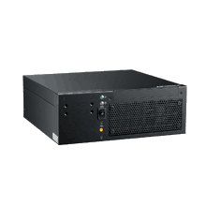
DSS Product SKU Offering
SKU/Config. | Server Quantity | Compute (CPU) | Memory (GB) | Physical Storage (TB)
Entry | *Master/Node x1 | 4 | 32 | 2
High Availability | *Master/Node x3 | 12 | 96 | 6
Expand | Node x1 | 4 | 32 | 2
Master
Master
Master
Master
Node
*Converged (Master) node running Kubernetes master and worker node on the same machine.

Slide 26
Data Service Server Software Roadmap
SPRINT IV
Deployment
Env Testing: NAS Deployment
Env Change: Change IP (Research)
HA (Three Nodes)
Software Component, v-1.4.x
LDAP
SPRINT III
Deployment
Scaling up, 1 -> 2
Software Component, v-1.3.x
Chart Marketplace
Logging Management
SPRINT II
Deployment
Two Nodes, HDD 1T/5T
Dynamic Configuration
Software Component, v-1.2.x
Chart Management
User Manual, Training Material
SPRINT I
Single Node (Master), HDD 1T/5T
Software Component, v-1.0.x
DeviceOn/EdgeSense Built-in
Private Chart Repo
Software Component, v-1.1.x
Private Docker Registry
Ceph Monitoring
2019/Jul
2019/Aug
2019/Oct
2019/Dec
2020/Q1

Slide 27


方案服務取得和訂購 from marketplace
200 Points / master node
* 1 Point = 10 USD
Data Server Package
買斷式授權
Included 10 EdgeSense/DeviceOn license and 3 months S/W service fee
*SW service included SW consulting and package upgrade

Slide 28
Choose the product that fits your needs
Features | DeviceOn | DeviceOn SDK
Architecture | Micro Service | Micro Service
EnSaaS (Cloud Foundry) | ● | ●
Kubernetes on Azure | ● | ●
EnSaaS (WISE-Stack) | ● | ●
Kubernetes on Edge AI Server | ● | ●
VM (Standalone) | ● | ●
Zero-touch Onboarding
Download Agent with Credential Configuration | ●
Mass Device Onbarding | ●
One-time configuration, onboarding automatically | ●
Operation Actions Management | ●
Action Control | ●
Action Scheduling | ●
Actions (Power On, Off, Reboot, Protection On/Off, Backup/Recovery, Update Agent) | ●
Embedde Remote Control
USB Lock | ●
Keyboard Filter & Lock | ●
Audio Volume Control | ●
Brighness Control | ●
Unified Write Filter (UWF) | ●
Screen On/Off | ●
Disable Touch Screen | ●
Disable Windows Notification | ●

Slide 29
Choose the product that fits your needs
 | DeviceOn | DeviceOn SDK
Account Management |  | ●
Single Sign On | ● | ●
Role-Based Permission Control | ● | ●
Group Management | ● | ●
Group Sharing | ● | ●
Muti-Groups (Device) | ● | ●
Device Management
IPC/Gateway Device | ● | ●
Muti-Layers Structure |  | ●
Device Sharing | ● | ●
Device Control
Remote Terminal | ● | ● (WebSocket)
Remote Screenshot | ● | ●
Remote Desktop (P2P, Repeater) | ● | ●
Remote Backup/Recovery (Acronis) | ● | ●
Remote Protection (McAfee) | ● | ●
Remote Process Control | ● | ●
Remote Power Action | ● | ●
Zero Downtime Transmission | ● | ●
Remote Sensor Control (Get/Set) | ◐ | ●
Rule Engine | ● | ● (All Plugins)
Intel AMT Management
Power, KVM (Local) | ● | ●
Event Management
Event Searching | ● | ●
Event Notification (Mail/SMS) | ● (+LINE/Wechat/Whatsapp) | ● (+LINE/Wechat)
OTA Management
Official Update (SRP, Agent) Policy (Read only Blob) | ● | ●
Package Management | ● | ●
Scheduling Deploy | ● | ●
Device Upgrade/3rd Party/Firmware/… | ● | ●
FTP, FTPS | ● | ●
Azure/Amazon/Baidu/Openstack Swift… | ● | ●

Slide 30
Production procedure
CTOS
SW RD
AE/FAE
Customer
Install Image
Ubuntu 16.04
Deploy Kubernetes
Function Check (HW/SW)
Oversea
DHL
Network Settings
System assembling (CPU/MEM/SSD/HDD)
Domestic
CTC
DeviceOn /
DeviceOn SDK

Slide 31
Go Together,
We Go Far and Grow Big

